Slide 1


LandLedger
Blockchain-Based Land Registry & Property Marketplace
DHA Phase 1, Rawalpindi · Ethereum Sepolia Testnet

Slide 2
Pakistan's Land Registry Crisis
Record Tampering
Land Fraud
No Transparency
Centralized databases allow unauthorized modifications
Fake claims, duplicate sales, forged documents
Ownership history locked behind single authority
Bureaucratic Delays
Broken Trust
Manual approvals, heavy intermediary dependency
Any database compromise threatens ownership integrity

Slide 3

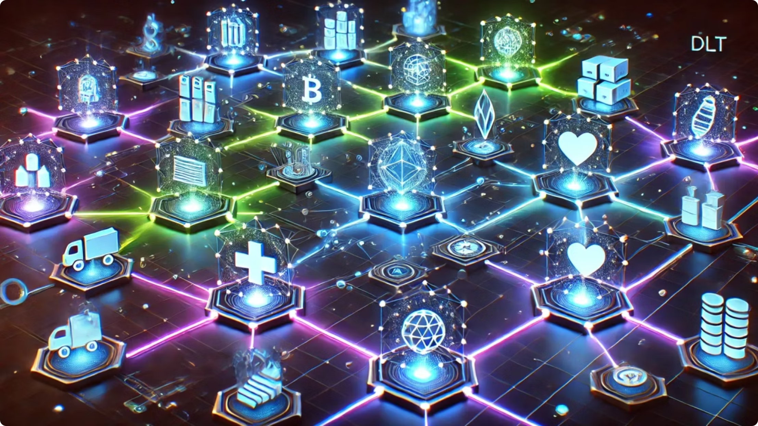
Why Blockchain? The LandLedger Approach
Immutability
Records cannot be altered or deleted
Transparency
Every transfer publicly verifiable
Decentralization
No single authority controls records
Security
Cryptographic wallets and digital signatures
Traceability
Complete ownership history on-chain

Slide 4
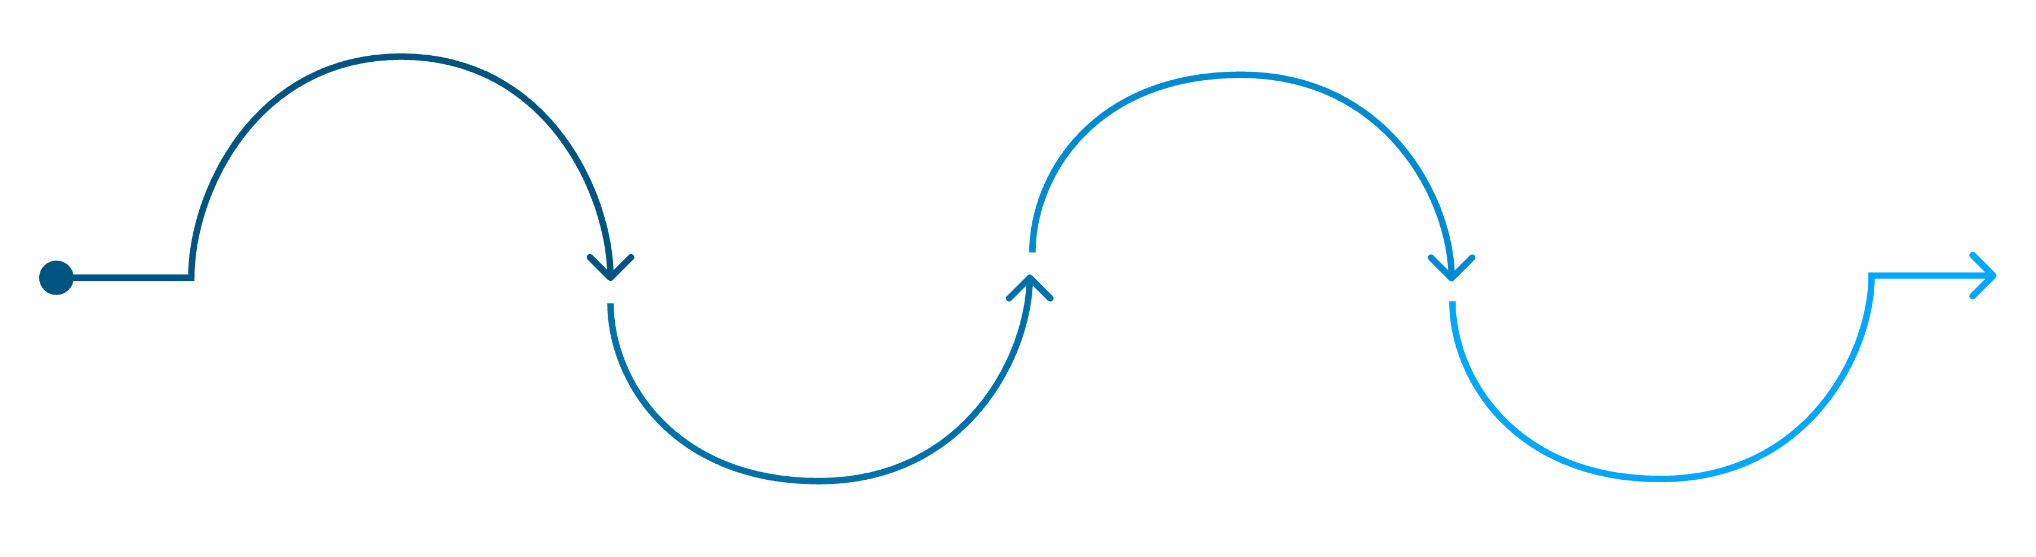
Core Architecture & On-Chain Registry
Ownership Transfer
Listing
Plot Registration
Purchase
New owner recorded and event logged on Etherscan
Owner lists plot for sale via smart contract
Buyer calls buyPlot() and ETH is transferred
Plot ID, size, owner wallet stored on-chain
Every DHA plot is a permanent on-chain record — registration, listing, purchase, and transfer all generate immutable blockchain events verifiable via Etherscan.

Slide 5
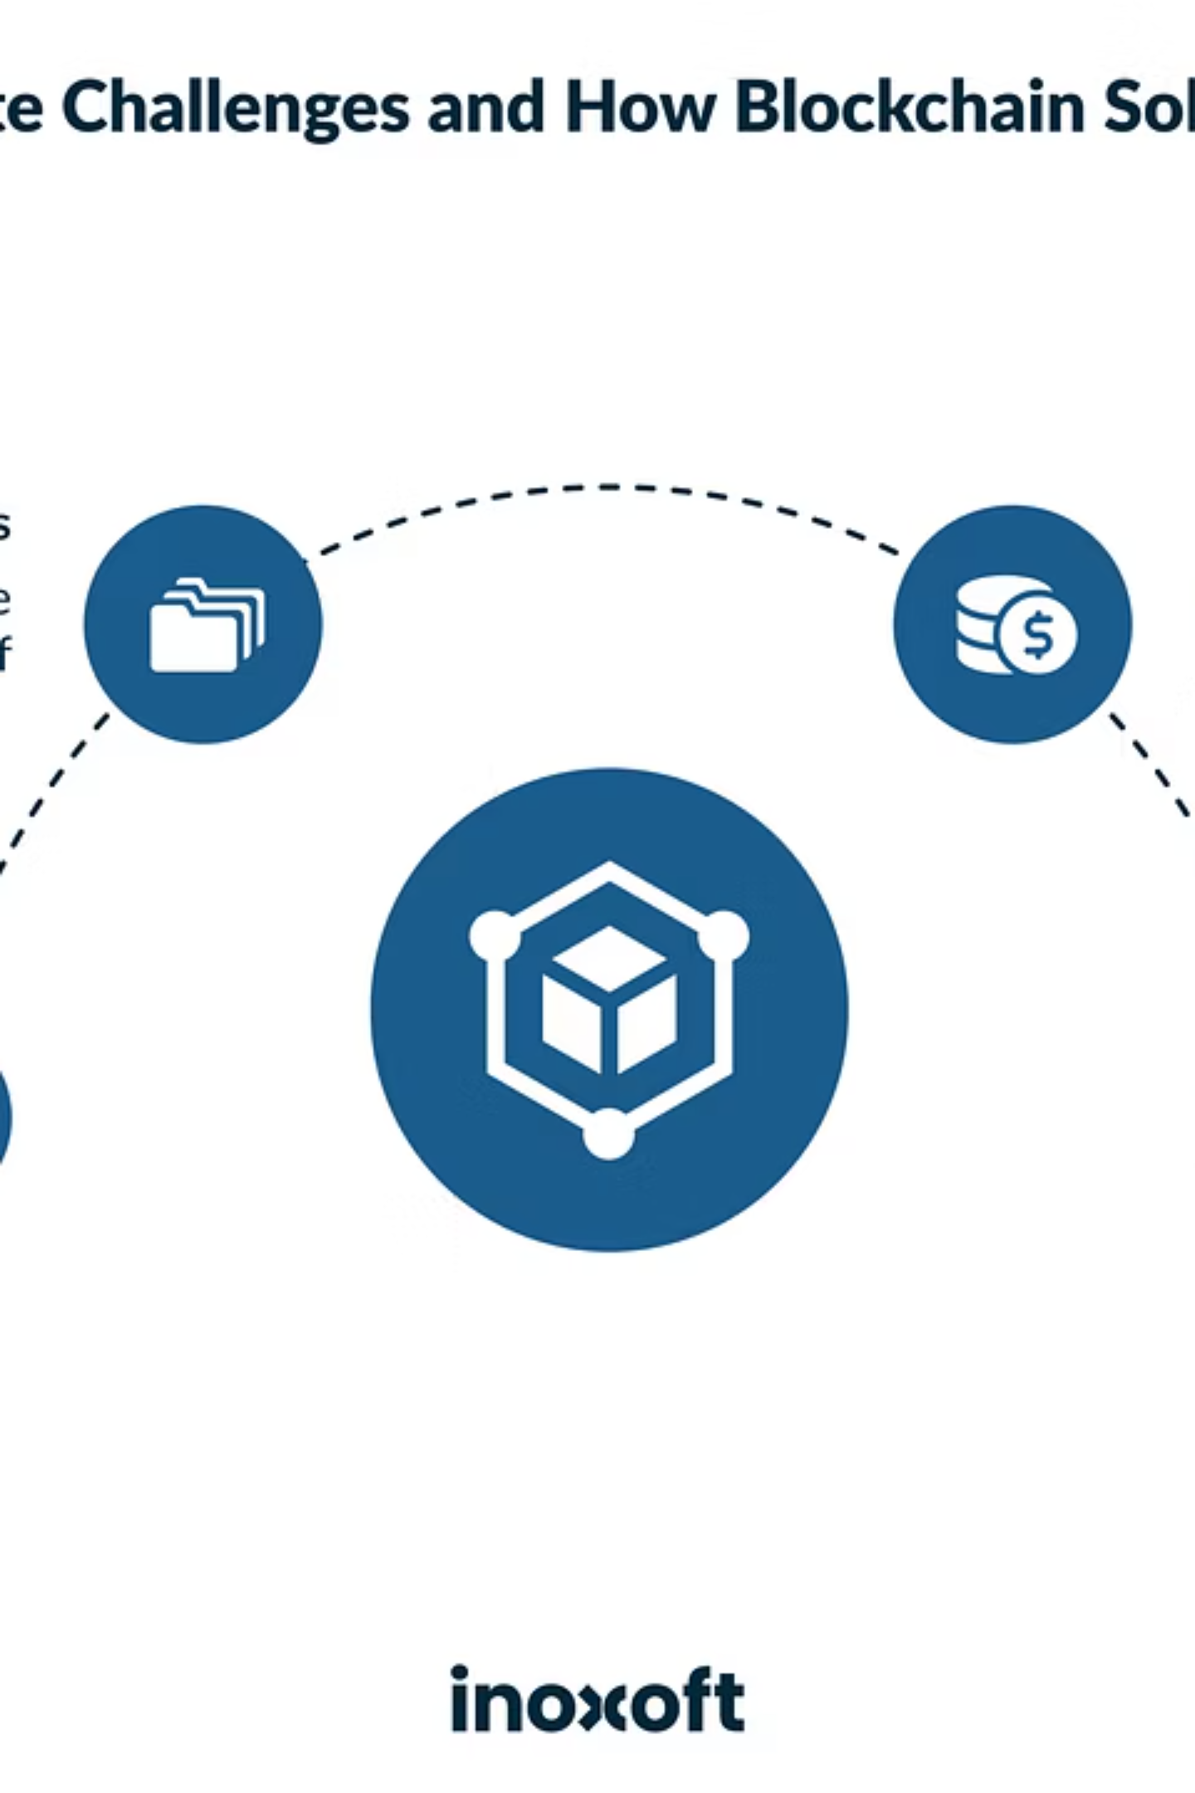
Property Marketplace & Smart Ownership Transfer
List
Owner sets price, lists plot on-chain
Buy
Buyer calls buyPlot() — no intermediaries
Transfer
Payment and ownership swap atomically
Verify
Transaction hash on Etherscan — instant proof

Slide 6
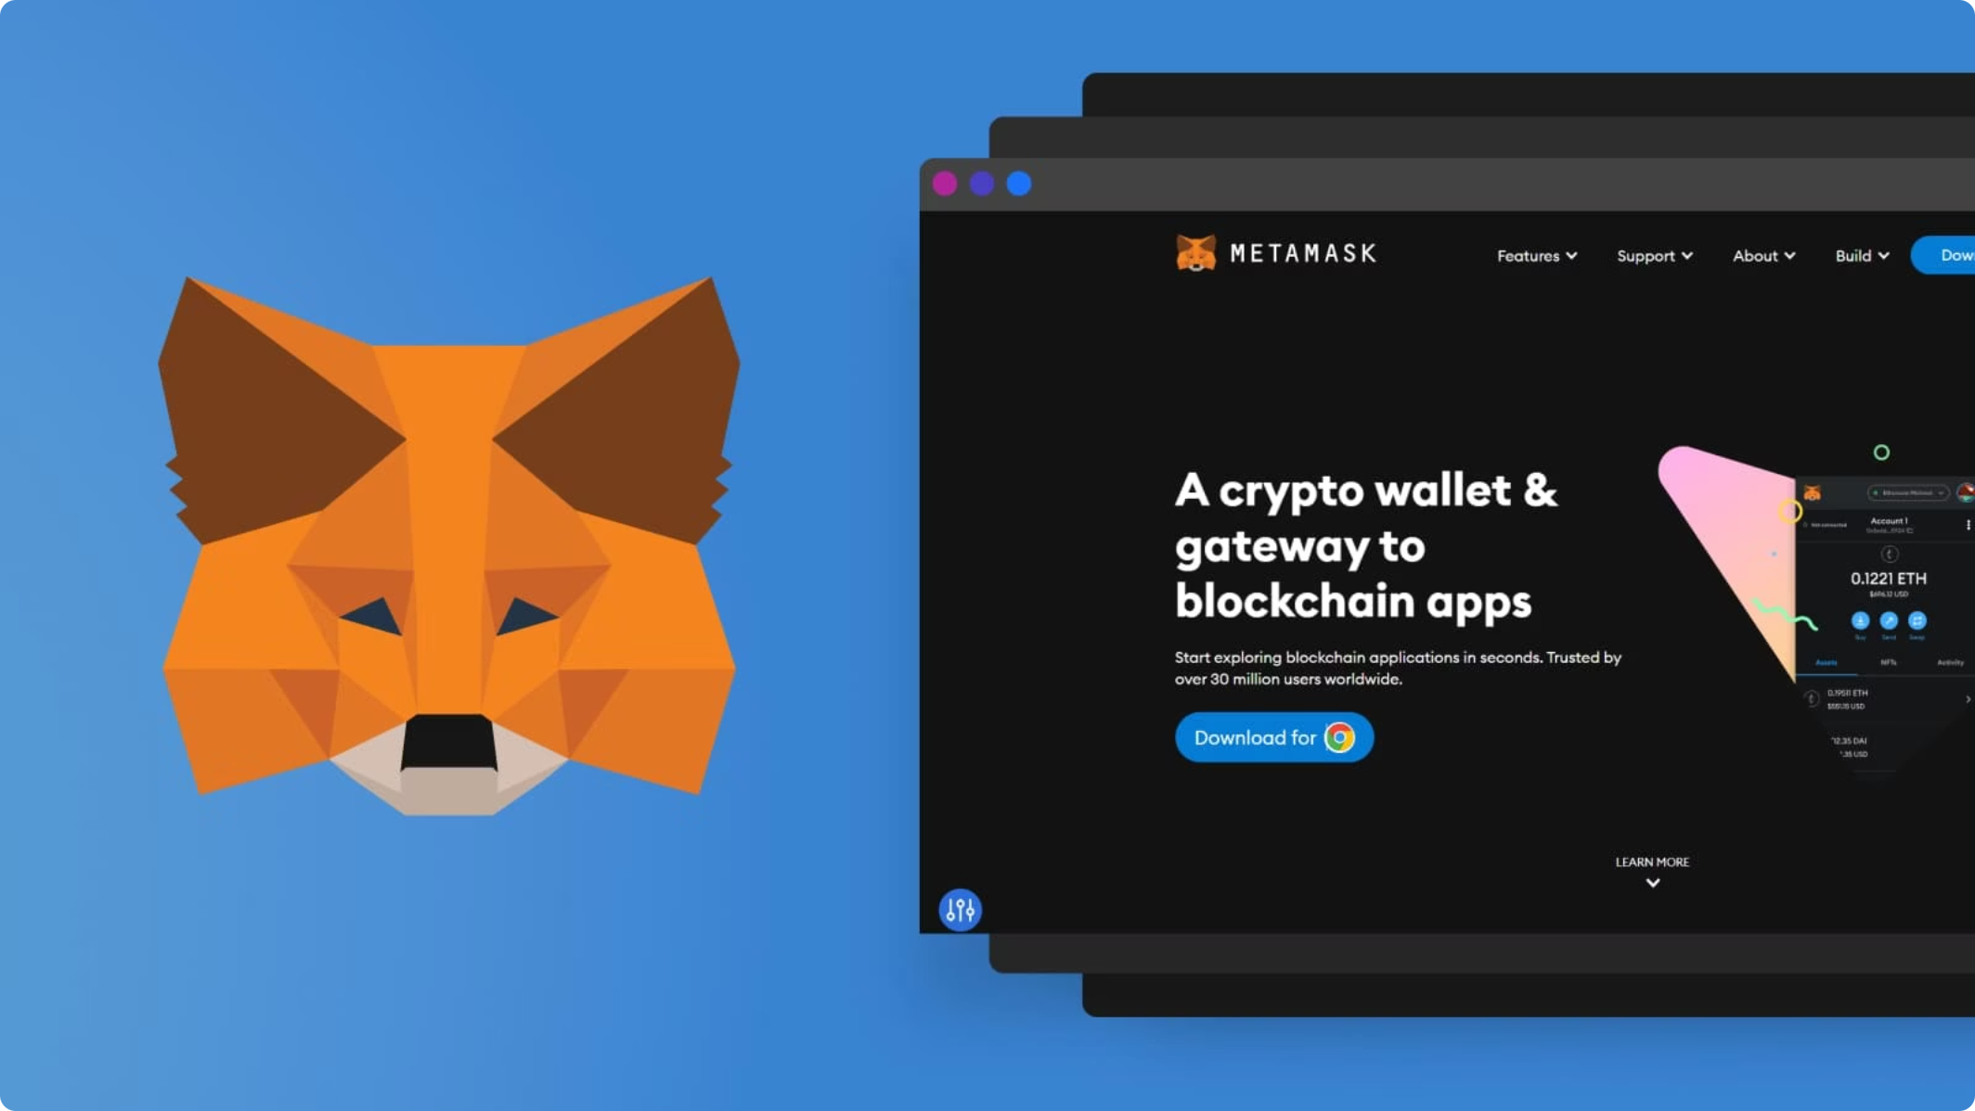
Advanced Features
Partial Ownership
Sell 25%, 50%, or 75% — smart contract auto-splits records
MetaMask Auth
Wallet as identity — cryptographic signatures replace paperwork
Live Verification
Full ownership history, transaction hashes, real-time tracking
Serverless Frontend
ethers.js — all data fetched directly from Ethereum

Slide 7
Current Limitations & Roadmap
What Remains Unresolved
Future Roadmap
01
Identity Verification
Physical Possession
Stablecoin Payments
Cannot verify encroachments or occupation
No CNIC or government ID linkage yet
Replace testnet ETH with real settlement
02
Government APIs
Legal Integration
Dispute Resolution
Integrate DHA and land department databases
Not yet connected to DHA or revenue authorities
Smart contract cannot handle court orders or inheritance conflicts
03
Escrow & Compliance
Regulatory-approved payment and dispute flows

